Slide 1
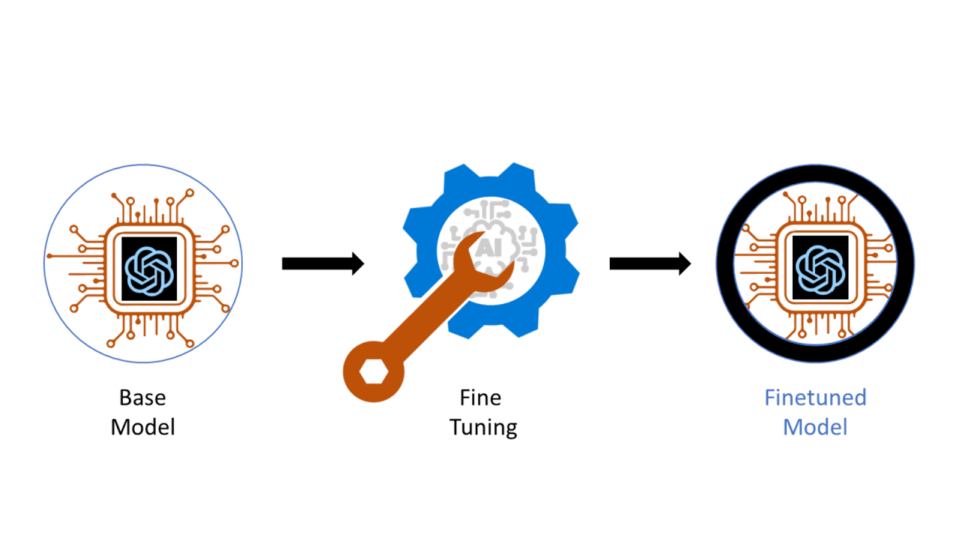
AppAgent & OSWorld
3.12.2026

Slide 2
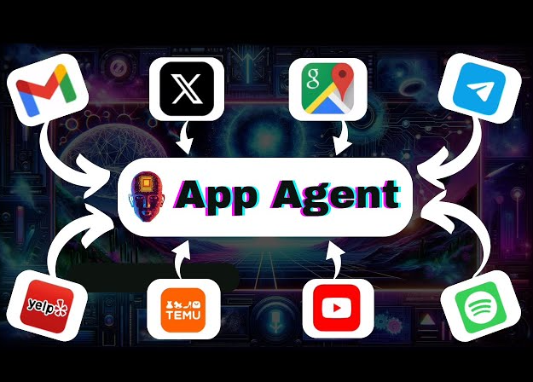
AppAgent: Multimodal Agents as Smartphone Users (Dec 2023)
LLM-based multimodal agent for smartphones: A new framework that allows an AI agent to operate smartphone apps using simple human-like actions such as tapping and swiping.
Proven performance across multiple apps: Testing on 50 tasks across 10 applications (e.g., social media, email, maps, shopping, image editing) shows the agent can successfully perform complex tasks across different apps.
Learning through exploration and demonstrations: The agent learns how to use new apps by exploring them autonomously or by observing human demonstrations, building a reusable knowledge base.
1/28

Slide 3
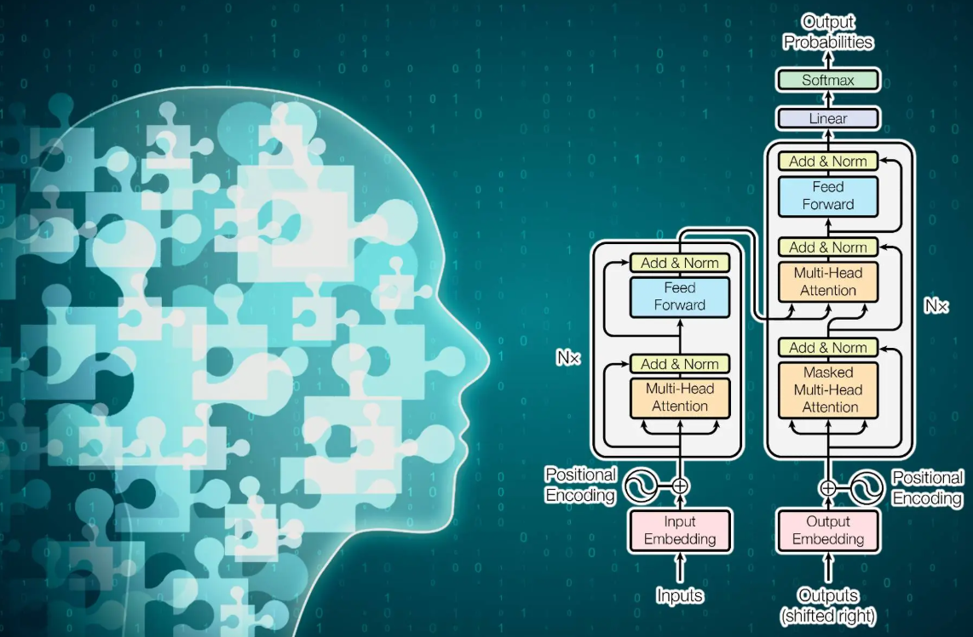
AppAgent: Multimodal Agents as Smartphone Users (Dec 2023)
Background and Motivation
Large Language Models (LLMs) such as ChatGPT and GPT-4 have significantly improved how machines understand and generate human language.
LLMs are now evolving into intelligent agents capable of performing complex tasks involving reasoning, planning, and collaboration (e.g., AutoGPT, MetaGPT).
However, traditional LLM agents rely mainly on text-based input, limiting their ability to perceive and interact with real-world environments.
1/28

Slide 4

AppAgent: Multimodal Agents as Smartphone Users (Dec 2023)
Proposed Multimodal Smartphone Agent
The study introduces a multimodal LLM-based agent that can operate smartphone applications using vision capabilities.
The agent interacts with apps through human-like GUI actions such as tapping and swiping instead of using system back-end access.
This design improves app compatibility, privacy, and adaptability, allowing the agent to work across many applications without deep system integration.
1/28

Slide 5
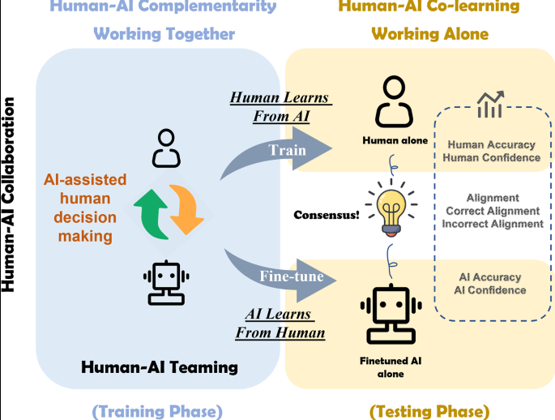
AppAgent: Multimodal Agents as Smartphone Users (Dec 2023)
Learning Approach and Key Contributions
The agent learns to use new apps through autonomous exploration and optional human demonstrations, building a knowledge base for future tasks.
Tested on 50 tasks across 10 different apps including social media, messaging, maps, shopping, and image editing.
Results show strong adaptability, efficient learning, and effective task execution, demonstrating the potential of AI-assisted smartphone app operation.
1/28

Slide 6

AppAgent: Multimodal Agents as Smartphone Users (Dec 2023)
Advancement of Large Language Models: Modern LLMs such as ChatGPT and GPT-4 enable multi-turn conversations and can follow complex instructions, significantly improving natural language processing capabilities.
Integration of Vision Capabilities: Models like GPT-4V combine language and visual understanding, allowing AI to interpret images, user interfaces, and perform tasks such as reasoning, coding, and tool usage.
Open-Source Multimodal Models and Challenges: Models based on LLaMA (e.g., LLaVA, ChartLlama, StableLLaVA) also support vision understanding, but they still show a performance gap compared to GPT-4V, especially when dealing with unfamiliar app interfaces.
1/28

Slide 7

AppAgent: Multimodal Agents as Smartphone Users (Dec 2023)
LLMs as intelligent agents: Models like AutoGPT, HuggingGPT, and MetaGPT demonstrate how LLMs can act as agents to perform complex tasks requiring reasoning, planning, and decision-making.
Applications across domains: LLM agents are used in areas such as software development, gaming, and interactive environments, where they can understand context, learn from interactions, and manipulate their environment.
Rise of multimodal agents: Multimodal LLM agents that process text, images, audio, and video enable more advanced tasks, including robotics, 3D asset generation, and multi-domain task completion, with this research focusing specifically on agents that operate smartphone applications.
1/28

Slide 8
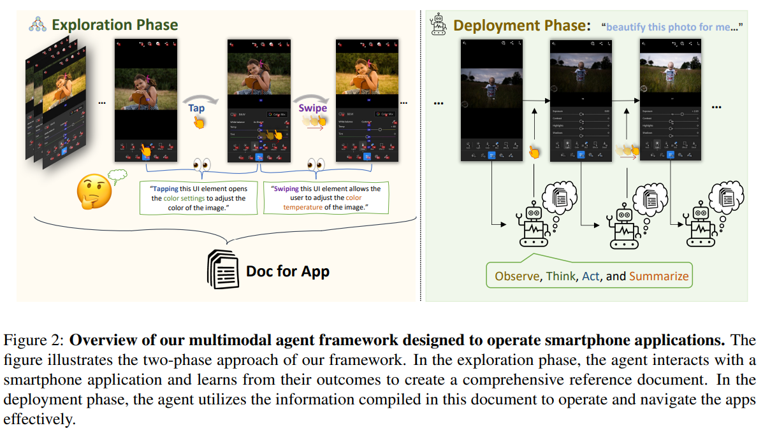
AppAgent: Multimodal Agents as Smartphone Users (Dec 2023)
1/28

Slide 9










AppAgent: Multimodal Agents as Smartphone Users (Dec 2023)
Method
Benchmark
-includes 10 popular applications, each serving various purposes.
Google Maps
Twitter
Telegram
YouTube
Spotify
Yelp
Gmail
TEMU
Clock
Lightroom
1/28

Slide 10
AppAgent: Multimodal Agents as Smartphone Users (Dec 2023)
Method
1. Environment and Action Space
The agent operates in an Android-based experimental environment using screenshots and XML files that describe UI elements.
Each interactive element is assigned a unique identifier to help the agent interact accurately.
The agent performs actions similar to human smartphone use, including tap, long press, swipe, text input, back, and exit.
2. Exploration Phase
The agent learns how smartphone apps work through autonomous exploration by interacting with UI elements and observing the results.
It records these interactions to build a document describing the functions of different elements.
Learning can also be improved by observing human demonstrations, which helps the agent understand complex app features more efficiently.
3. Deployment Phase
After learning, the agent uses its stored knowledge to complete tasks step-by-step.
It analyzes screenshots, reasons about the task, and selects appropriate actions based on previous interactions.
The process continues until the task is completed, at which point the agent ends the operation using the exit function.
1/28

Slide 11
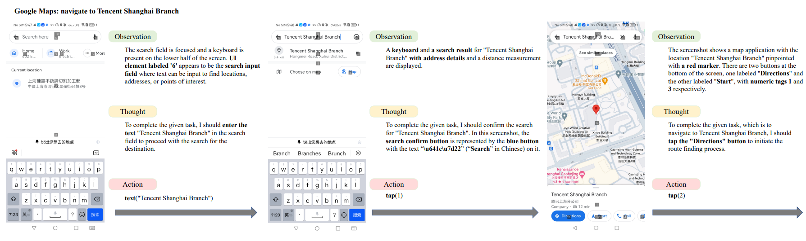
AppAgent: Multimodal Agents as Smartphone Users (Dec 2023)
Qualitative Task Evaluation Across Three Apps
Qualitative Task Evaluation Across Three Apps. This figure presents qualitative results for three distinct tasks conducted on Google Maps, Gmail, and Lightroom. It showcases AppAgent’s ability to accurately perceive, reason, and execute tasks, demonstrating its competence in various application contexts. Due to space constraints, some less critical details have been omitted from the description.
1/28

Slide 12
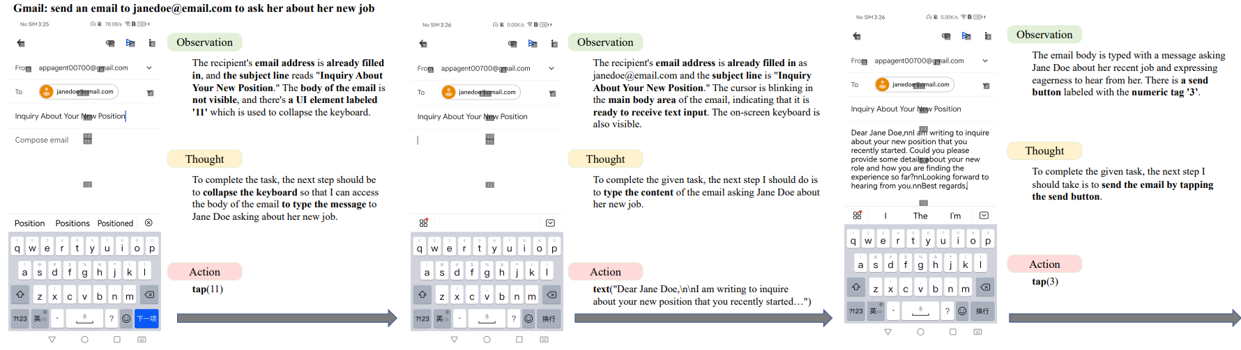
AppAgent: Multimodal Agents as Smartphone Users (Dec 2023)
Qualitative Task Evaluation Across Three Apps
Qualitative Task Evaluation Across Three Apps. This figure presents qualitative results for three distinct tasks conducted on Google Maps, Gmail, and Lightroom. It showcases AppAgent’s ability to accurately perceive, reason, and execute tasks, demonstrating its competence in various application contexts. Due to space constraints, some less critical details have been omitted from the description.
1/28

Slide 13
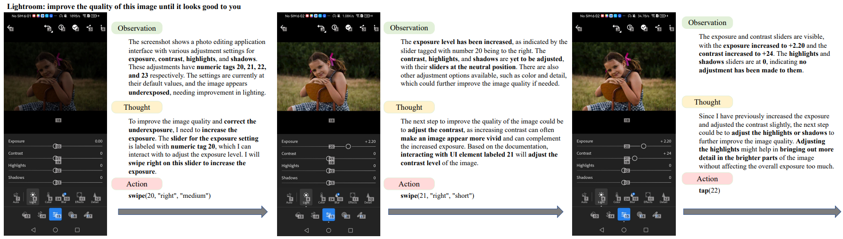
AppAgent: Multimodal Agents as Smartphone Users (Dec 2023)
Qualitative Task Evaluation Across Three Apps
Qualitative Task Evaluation Across Three Apps. This figure presents qualitative results for three distinct tasks conducted on Google Maps, Gmail, and Lightroom. It showcases AppAgent’s ability to accurately perceive, reason, and execute tasks, demonstrating its competence in various application contexts. Due to space constraints, some less critical details have been omitted from the description.
1/28

Slide 14
AppAgent: Multimodal Agents as Smartphone Users (Dec 2023)
Qualitative Task Evaluation Across Three Apps
1/28

Slide 15
AppAgent: Multimodal Agents as Smartphone Users (Dec 2023)
Qualitative Task Evaluation Across Three Apps
1/28

Slide 16
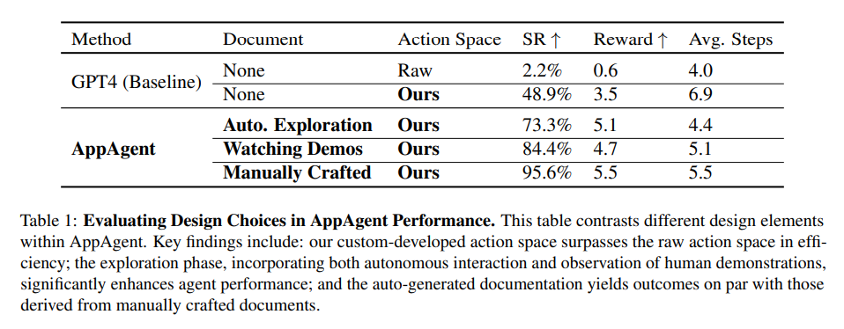
AppAgent: Multimodal Agents as Smartphone Users (Dec 2023)
Case Study
1/28

Slide 17
AppAgent: Multimodal Agents as Smartphone Users (Dec 2023)
Experiments
Experimental Evaluation
Benchmark with 10 Popular Apps: Tested on apps such as Google Maps, Twitter, Telegram, YouTube, Spotify, Gmail, TEMU, Clock, Yelp, and Adobe Lightroom to evaluate adaptability across different interfaces.
Case Study on Visual Tasks: Adobe Lightroom was used to assess the agent’s ability to interpret images and perform image-editing tasks using visual understanding.
Experiment Setup: Exploration phase limited to 40 steps and testing to 10 steps, using the GPT-4 multimodal model to process both text and image inputs for effective app interaction.
Design and Analysis
Baseline Comparisons: Different configurations were tested, including GPT-4 with raw action APIs, simplified action spaces, and guidance documents generated through autonomous exploration, human demonstrations, or manual creation.
Evaluation Metrics: Performance was measured using Success Rate (SR), Reward scores based on progress toward task completion, and Average Steps required to finish tasks.
Results and Findings: The simplified action space significantly improved GPT-4’s performance, and documents generated from exploration or human demonstrations performed nearly as well as manually written guides, showing strong effectiveness across multiple apps.
1/28

Slide 18
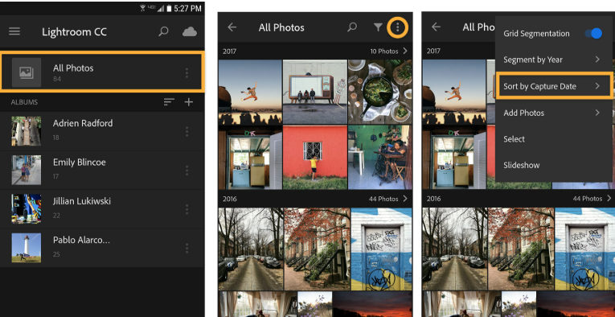
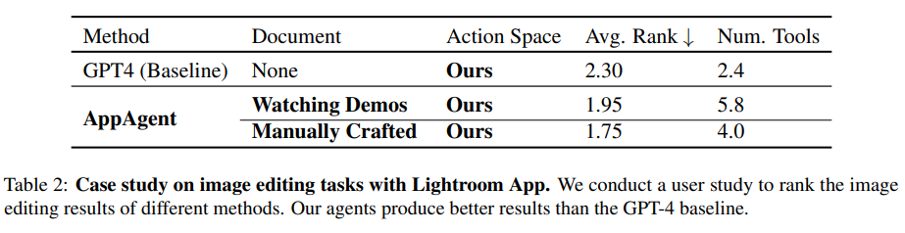
“fix this image until it looks good to you”
AppAgent: Multimodal Agents as Smartphone Users (Dec 2023)
Case Study
Lightroom Case Study: The agent was tested on Adobe Lightroom to evaluate its ability to perform complex visual tasks such as selecting editing tools and adjusting image parameters.
Experiment Setup: Five images with issues like low contrast and overexposure were edited by different model versions, and a user study ranked the quality of the edited images.
Key Findings: The agent using generated guidance documents produced better editing results than the GPT-4 baseline and used a wider range of editing tools, demonstrating improved performance and the effectiveness of the exploration phase.
1/28

Slide 19
AppAgent: Multimodal Agents as Smartphone Users (Dec 2023)
Conclusion
Proposed Framework: The study introduces a multimodal agent that uses the vision capabilities of large language models to operate smartphone apps through human-like interactions.
Key Advantages: The system does not require system back-end access and can adapt to new apps using an exploration-based learning strategy, making it flexible and secure.
Limitation: The simplified action space does not support advanced gestures such as multi-touch, which may limit performance in more complex interaction scenarios.
1/28

Slide 20

AppAgent: Multimodal Agents as Smartphone Users (Dec 2023)
QUESTIONS

Slide 21


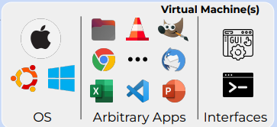

OSWORLD: Benchmarking Multimodal Agents for Open-Ended Tasks in Real Computer Environments (May 2024)
Abstract
Introduction of OSWORLD: A scalable real computer environment designed to evaluate multimodal AI agents performing complex computer tasks across operating systems like Ubuntu, Windows, and macOS.
Key Findings: Testing shows a large performance gap between humans and current AI agents—humans complete over 72% of tasks, while the best model achieves only 12.24%, highlighting challenges in GUI understanding and operational knowledge.
Comprehensive Benchmark: OSWORLD includes 369 real-world tasks involving web and desktop applications, file operations, and multi-application workflows, enabling reliable and reproducible evaluation.
15/28

Slide 22
OSWORLD: Benchmarking Multimodal Agents for Open-Ended Tasks in Real Computer Environments (May 2024)
Motivation – Autonomous Computer Agents
Humans perform many digital tasks (web browsing, file management, coding, video editing) using multiple applications through GUI and CLI interfaces.
Vision-Language Model (VLM) agents could automate these tasks using natural language instructions, improving accessibility and productivity.
However, progress is limited because existing benchmarks lack realistic interactive computer environments that reflect real-world computer usage.
OSWORLD – A Real Computer Environment
Introduces OSWORLD, the first scalable real computer environment for evaluating multimodal AI agents.
Supports real applications, keyboard/mouse interactions, and multiple operating systems (Ubuntu, Windows, macOS).
Includes a benchmark of 369 real-world computer tasks involving web apps, desktop software, file operations, and multi-application workflows.
Key Findings and Contributions
Evaluation of leading models (GPT-4V, Gemini, Claude, Llama, Mixtral) shows very low success rates (0.99%–12.24%), far below human performance.
Agents struggle with GUI understanding, precise action prediction, unexpected interface changes, and app-specific knowledge.
OSWORLD is open-source and aims to advance research toward general-purpose AI agents capable of real computer tasks.
15/28

Slide 23
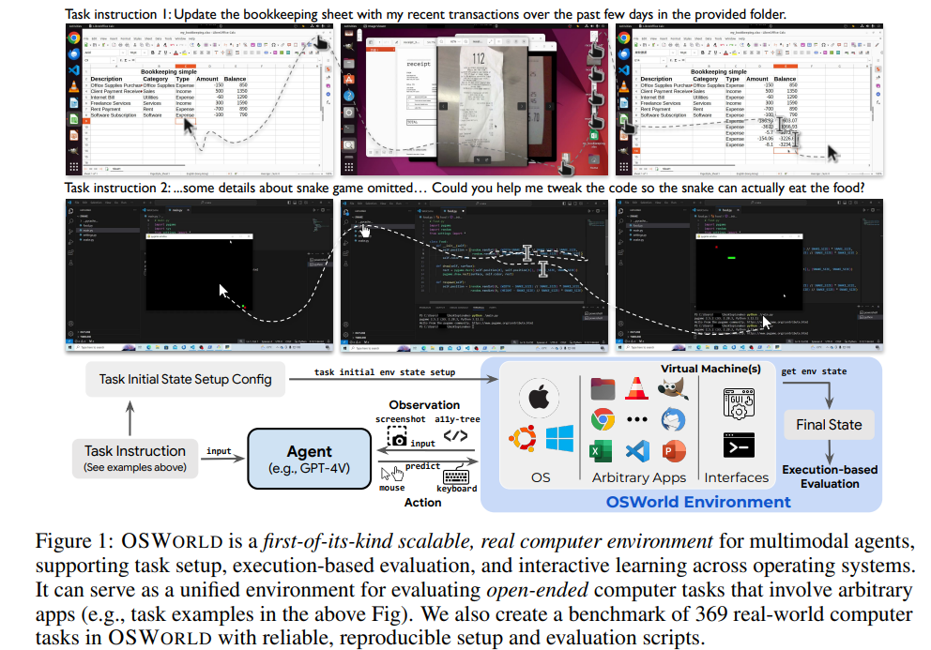
OSWORLD: Benchmarking Multimodal Agents for Open-Ended Tasks in Real Computer Environments (May 2024)
15/28

Slide 24
OSWORLD: Benchmarking Multimodal Agents for Open-Ended Tasks in Real Computer Environments (May 2024)
Motivation – Autonomous Computer Agents
Humans perform many digital tasks (web browsing, file management, coding, video editing) using multiple applications through GUI and CLI interfaces.
Vision-Language Model (VLM) agents could automate these tasks using natural language instructions, improving accessibility and productivity.
However, progress is limited because existing benchmarks lack realistic interactive computer environments that reflect real-world computer usage.
OSWORLD – A Real Computer Environment
Introduces OSWORLD, the first scalable real computer environment for evaluating multimodal AI agents.
Supports real applications, keyboard/mouse interactions, and multiple operating systems (Ubuntu, Windows, macOS).
Includes a benchmark of 369 real-world computer tasks involving web apps, desktop software, file operations, and multi-application workflows.
Key Findings and Contributions
Evaluation of leading models (GPT-4V, Gemini, Claude, Llama, Mixtral) shows very low success rates (0.99%–12.24%), far below human performance.
Agents struggle with GUI understanding, precise action prediction, unexpected interface changes, and app-specific knowledge.
OSWORLD is open-source and aims to advance research toward general-purpose AI agents capable of real computer tasks.
15/28

Slide 25
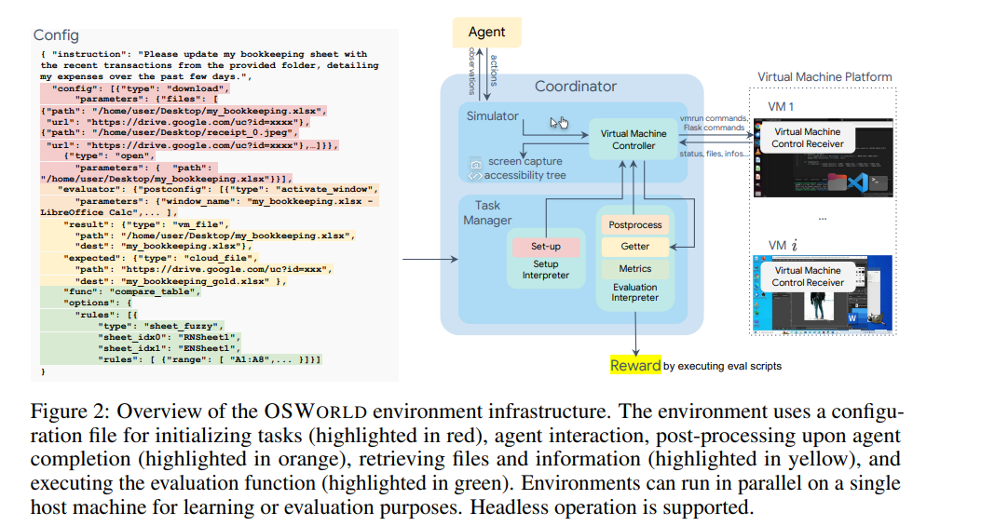
OSWORLD: Benchmarking Multimodal Agents for Open-Ended Tasks in Real Computer Environments (May 2024)
15/28

Slide 26
OSWORLD: Benchmarking Multimodal Agents for Open-Ended Tasks in Real Computer Environments (May 2024)
Real Computer Environment Infrastructure
Executable Real Computer Environment: OSWORLD provides a controllable environment that supports task setup, execution-based evaluation, and agent learning across operating systems such as Ubuntu, Windows, and macOS.
Virtual Machine Infrastructure: The system uses virtual machines to create a safe, isolated environment that prevents damage to the host system and allows quick resets using snapshots.
Configurable Task Setup and Evaluation: Tasks are managed through configuration files that handle environment initialization, post-processing, data collection, and evaluation functions to ensure accurate task assessment.
15/28

Slide 27
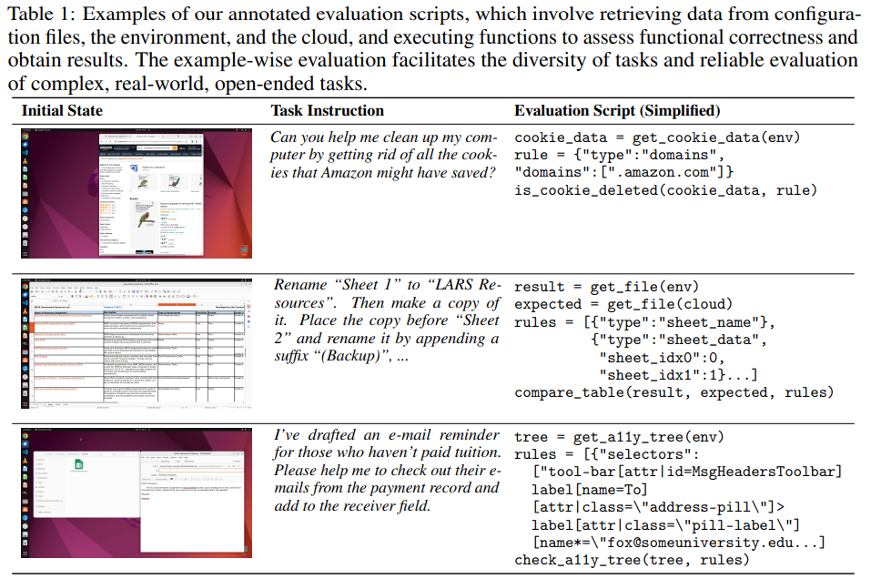
OSWORLD: Benchmarking Multimodal Agents for Open-Ended Tasks in Real Computer Environments (May 2024)
Execution-Based Evaluation
15/28

Slide 28
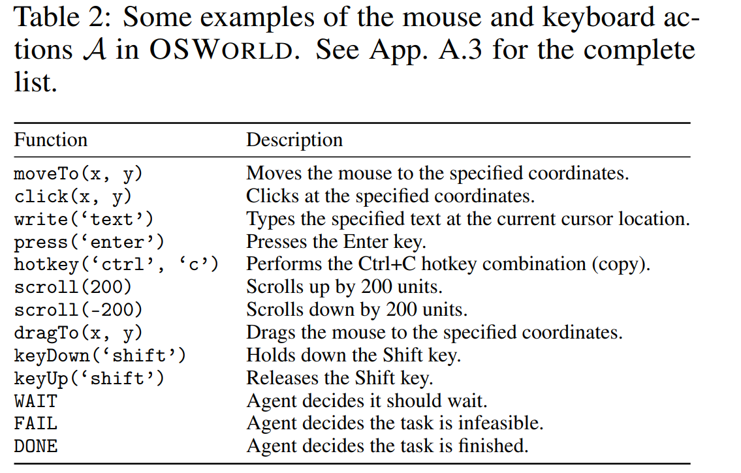
OSWORLD: Benchmarking Multimodal Agents for Open-Ended Tasks in Real Computer Environments (May 2024)
Action Space
15/28

Slide 29
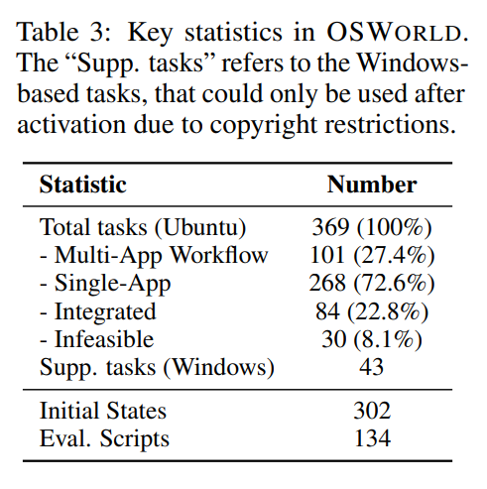
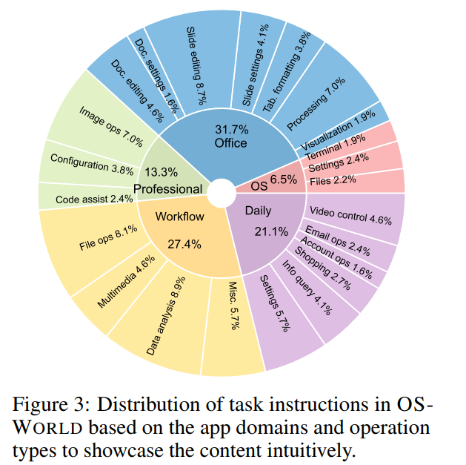
OSWORLD: Benchmarking Multimodal Agents for Open-Ended Tasks in Real Computer Environments (May 2024)
Data Statistics
15/28
Notes:
these categories include OS,
Office (LibreOffice Calc, Impress, Writer),
Daily (Chrome, VLC Player, Thunderbird),
Professional (VS Code and GIMP),
and Workflow (tasks involving multiple apps).
OSWORLD contains a total of 369 tasks (and an additional 43 tasks on Windows for analysis), with the majority (268 tasks or 72.6%) aiming at single application functionalities and a remarkable section of workflow-related tasks (101 tasks or 27.4%). The dataset’s diversity is further affirmed by the inclusion of tasks considered infeasible, totaling 30 tasks or 8.1% of the dataset. Additionally, a total of 84 tasks (22.8%) are integrated from related datasets, highlighting the dataset’s applicability in universal modeling. Remarkably, the dataset incorporates 302 distinct initial states and 134 different evaluation scripts, underscoring the comprehensive approach towards evaluating the tasks’ complexity and requirements

Slide 30
Gorilla: Large Language Model Connected with Massive APIs
QUESTIONS

Slide 31
END
3.12.2026

